Slide 1
The Software Industry
Prof. Dr. Dirk Riehle
Friedrich-Alexander University Erlangen-Nürnberg
COSS B01
Licensed under CC BY 4.0 International
Notes:
It is Friedrich-Alexander University Erlangen-Nürnberg – FAU, in short.
Corporate identity wants us to say “Friedrich-Alexander University”.

Slide 2
Agenda
Definition (software)
The software industry
A (very) short history
The main players
Software products
Software platforms
Software ecosystems

Slide 3
1. What is Software?

Slide 4
Software Definition
Software (technical definition)
  Is a set of instructions to make computers perform work
  Can come in several equivalent forms (source, binary)
  Is formed into components and programs
  Programs can be built from components
Software (economic definition)
  Is a digital good that can be sold

Slide 5
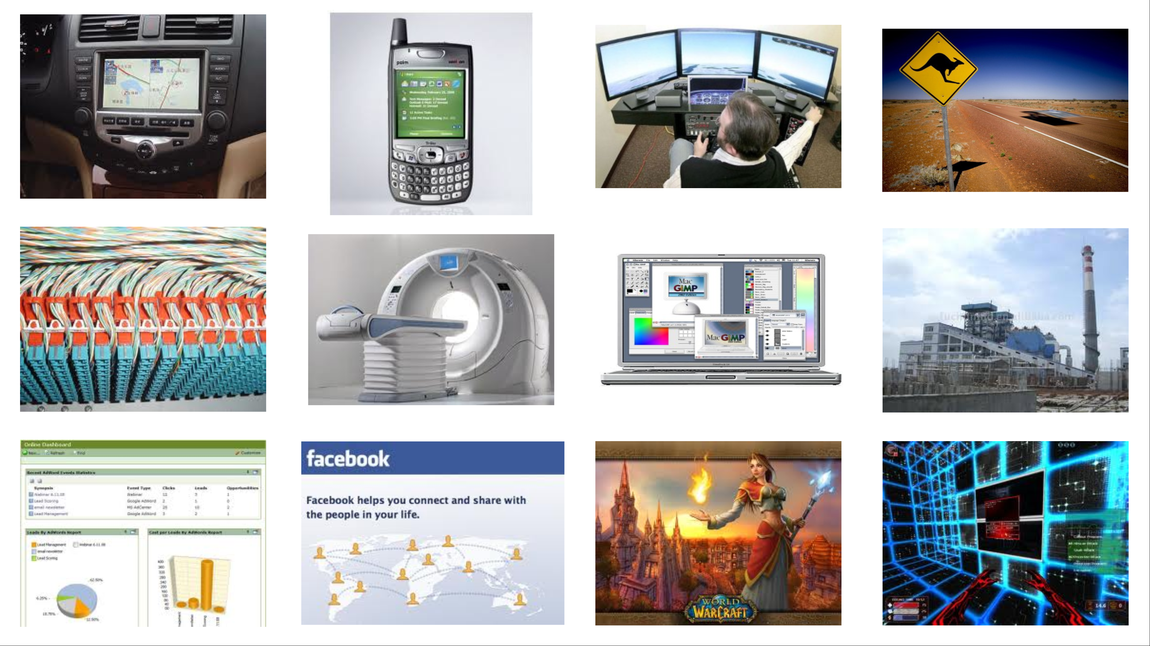

Slide 6
Software as a Product
A product
  Is a man-made artifact sold to customers in a market
  Has a life-cycle
    Is born,
    Grows and matures,
    Eventually dies
A software product is a product that
  Is intellectual property
  Is non-physical, does not rot
  Has near-zero copying costs
  Is extremely malleable

Slide 7
2. The Software Industry

Slide 8
The Software Industry
The software industry
  Is the set of businesses that provide
    Software products and
    Software services such as
      Operating services
      Consulting services
        Development services
        Implementation services
  to other industries as well as itself
The software industry
  Is highly concentrated
  Is highly internationalized
  Has strong network effects
  Has a high speed of innovation
  Is rapidly expanding into new domains

Slide 9
Global Information Technology (IT) Spending [1] in US$bn
 | 2019 Spending | 2019 Growth (%) | 2020 Spending | 2020 Growth (%) | 2021 Spending | 2021 Growth (%)
Data Center Systems | 205 | -2.7 | 208 | 1.9 | 212 | 1.5
Enterprise Software | 456 | 8.5 | 503 | 10.5 | 556 | 10.5
Devices | 682 | -4.3 | 688 | 0.8 | 685 | -0.3
IT Services | 1,03 | 3.6 | 1,081 | 5.0 | 1,14 | 5.5
Comm. Services | 1,364 | -1.1 | 1,384 | 1.5 | 1,413 | 2.1
Overall IT | 3,737 | 0.5 | 3,865 | 3.4 | 4,007 | 3.7
[1] From https://www.gartner.com/en/newsroom/press-releases/2020-01-15-
gartner-says-global-it-spending-to-reach-3point9-trillion-in-2020

Slide 10
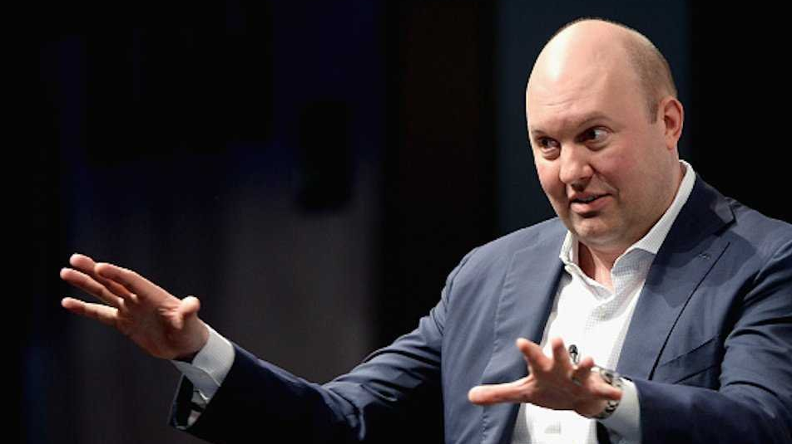
“Software is eating the world”
Wall Street Journal
2011-08-20

Slide 11
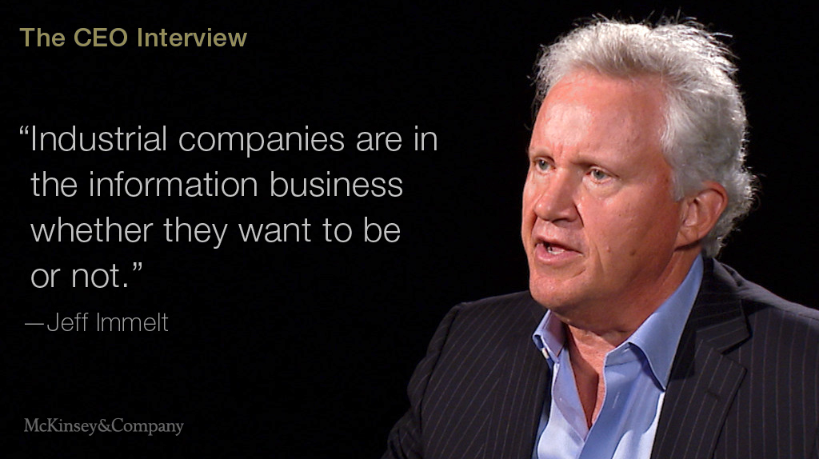
GE is a Software Company

Slide 12
Change and Innovation at the Speed of Software
Products increasingly include software components
  Hardware components traditionally have long innovation cycles
  Software has a significantly faster innovation cycle
  Innovation speed is continuously increasing
Products are being adapted to take advantage of software
  Products can be reconfigured at speed of software
  Products evolve at speed of software innovation
Examples increased innovation speed
  Cars are fully delivered with features switched off
  Cars evolve at speed of over-the-air update
Software is eating established industries and products
[1] See https://dirkriehle.com/2019/12/09/the-first-derivative-of-software-is-eating-the-world/

Slide 13
Societal Significance of Software and Software Systems
Software and software systems are changing society
  Empowerment vs. stratification
  Enlightenment vs. misinformation
  Sociability vs. isolation
Internet and email have become basic utilities

Slide 14
3. A (Very) Short History

Slide 15
Short History of the Software Industry
1959
  First mentioning of term “software”
1969
  US Dept. of Justice separates hardware from software in landmark decision
1980ties
  From vertical to horizontal integration; growth of platforms and ecosystems
1990ties
  Centralization, dominance of Windows
2000ties
  Diversification, multiple platforms; growth of open source software
2010ties
  Back to vertical integration in the form of cloud computing

Slide 16
Vertical Integration (Until 1980ties)
IBM
DEC
Services
Services
Applications
Applications
Operating System
Operating System
Hardware
Hardware

Slide 17
Horizontal Integration (Since 1990ties)
Services
IBM
Accenture
Tata
Applications
Microsoft Word
GIMP
Twitter
Operating
System
Windows
Linux
OS X
Hardware
IBM
Dell
Samsung

Slide 18
Cloud Computing (Since 2000ties)
AWS
GCP
Apps
SaaS
Platform
Services
Platform
Services
PaaS
Operating
System
Operating
System
IaaS
Hardware
Hardware

Slide 19
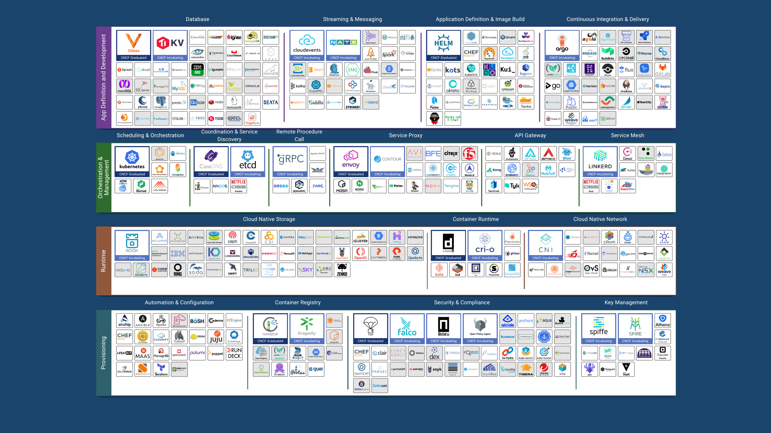
[1] https://landscape.cncf.io/

Slide 20
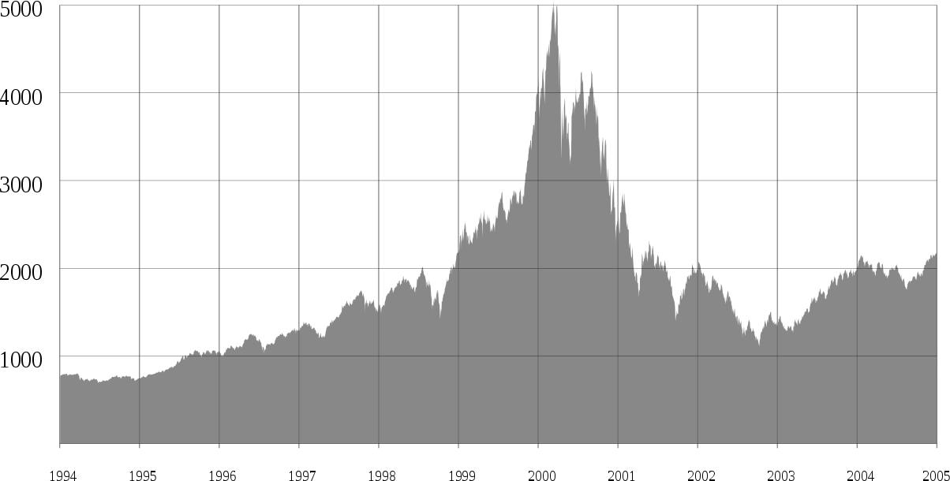
The “Dot-Com” Bubble and Burst (1995-2000)
[1] See https://en.wikipedia.org/wiki/File:Nasdaq_Composite_dot-com_bubble.svg

Slide 21
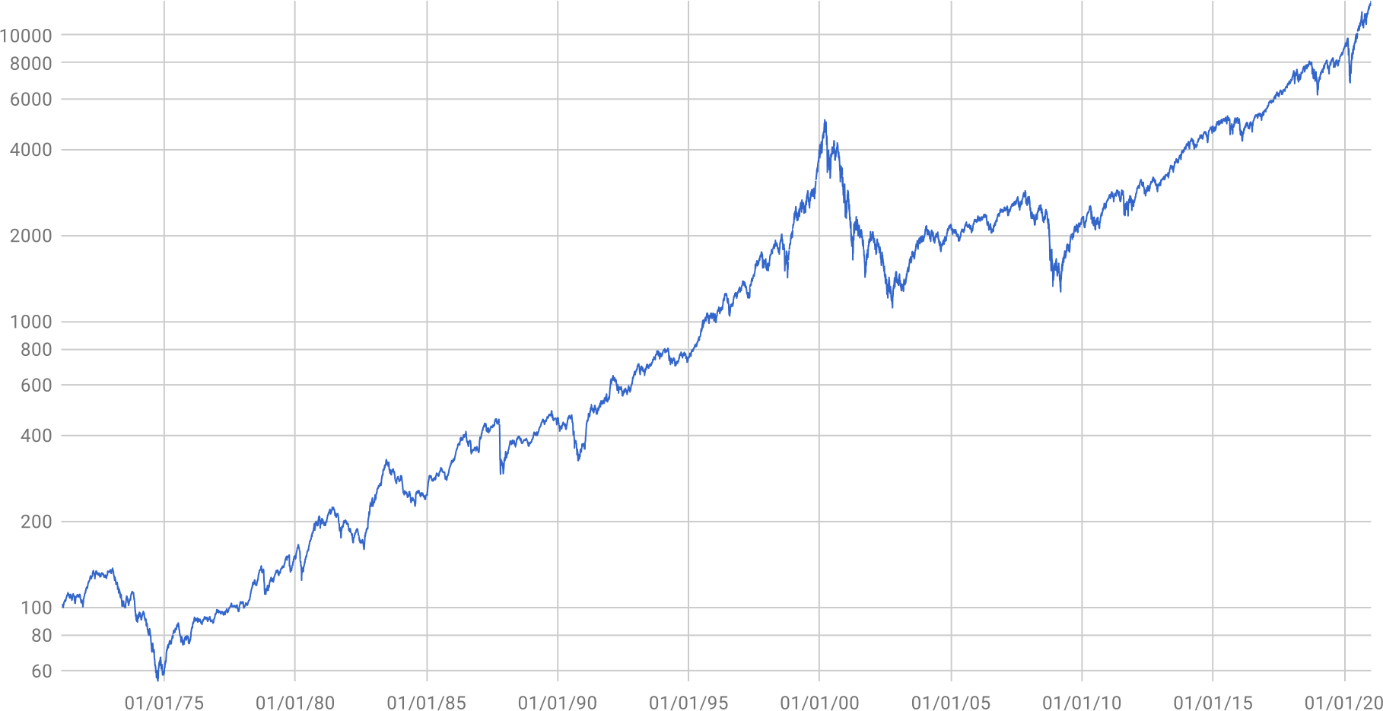
The NASDAQ Composite Index 1971-2021 [1]
[1] By Seriesofsines, own work, CC0, Wikimedia Commons

Slide 22
4. The Main Players

Slide 23
The Main Types of Industry Players
Standard product providers
  (Independent) software vendors (ISVs)
    Produce software products (“standard software” or “commercial off-the-shelf software”)
  Cloud service providers (e.g. “Internet companies”)
    Operate any form of software (and hardware)
Software consulting firms
  Development services firms
    Produce custom software
  Implementation services firms
    Configure software products for use by customers
Non-profit organizations
  Standards organizations
  Regulatory bodies
  Certification agencies

Slide 24
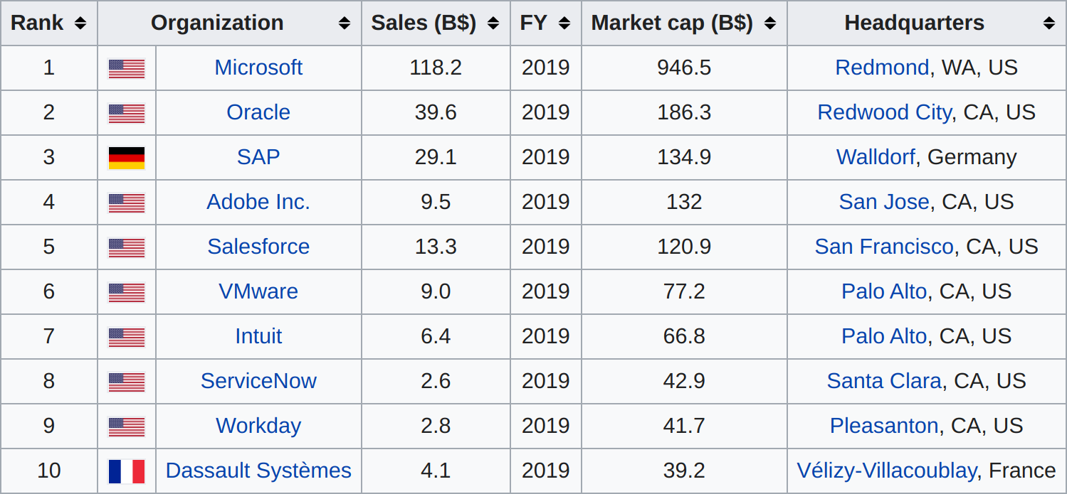
Top 10 Independent Software Vendors (ISVs) in 2019 [1]
[1] Forbes Global 2020, see https://en.wikipedia.org/wiki/List_of_the_largest_software_companies

Slide 25





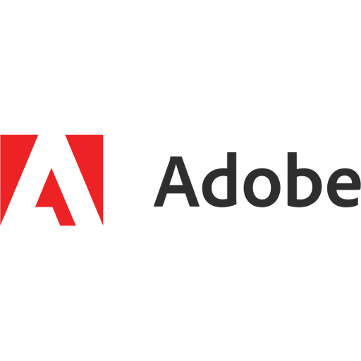


Software Vendors vs. “Internet Companies” [1]
[1] See https://en.wikipedia.org/wiki/List_of_largest_Internet_companies

Slide 26
Software Vendors vs. Service Provider / Operator
Software vendor
  Product is a licensed-out artifact
Examples (before cloud offering)
  Microsoft
  Oracle
  SAP
  Adobe
Service provider / operator
  Product is a standardized service
Examples
  Amazon Web Services (if it was broken out)
  Various Google services
  Salesforce
  Facebook

Slide 27


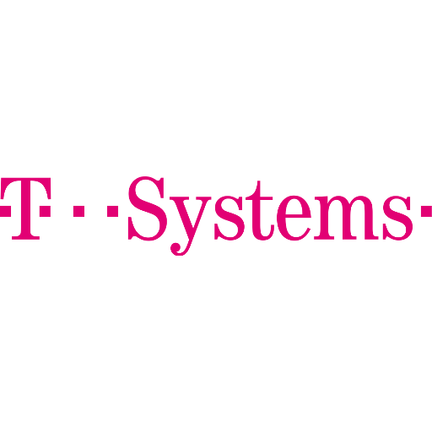
Software Vendors, Consulting Firms, and Service Providers
Software
Vendor
Development
Service
Implementation
Service
Cloud Service
Provider
S/4 Hana
S/4 Hana
Extended
S/4 Hana
Extended
Configured
S/4 Hana
Extended
Configured
Operated

Slide 28
Standards Organizations
A standards organization
  Is a public (often non-governmental) organization financed by industry
  That serves as meeting point and platform to define industry standards
  Conformance to which may be required before admission to market
  Is one player (of three) in standards and certification processes
Examples
  ISO (“International Standards Organization”)
  VDE (“Verband der Elektrotechnik”)
  VDA (“Verband der Automobilindustrie”)

Slide 29
Regulatory Bodies (Regulators)
A regulatory body
  Is a public organization or government agency (state-level, federal-level, union-level)
  Which by way of laws and directives regulates industries and industry player behavior
  To protect the public by preventing undesired behavior and enforcing desired one
Examples
  European Union
    European commission → Data protection (GDPR) → Enforcement by Information Commissioner’s Office (ICO)
  U.S.A.
    Federal and state governments → Antitrust law → Enforcement by Federal Trade Commission (FTC), DoJ

Slide 30
Certification Agencies
A certification agency
  Is a non-profit organization that provides certification services for given standards
SB
SB = Standards body
CA = Certification agency
ST = Standards trainer
CA
ST

Slide 31
5. Software Products

Slide 32
Consumer vs. Enterprise Customers
Retail customers (B2C)
  Are willing to trade time for money
Enterprise customers (B2B)
  Are willing to trade money for time

Slide 33
Consumer vs. Enterprise Software Products (and Markets)
Consumer (retail) products
  Pricing
    Comparatively cheap
    Often free, then subsidized
  Segmentation
    Usually by demographics, e.g.
      By age group
      By gender
  Adoption
    Out of the box
Enterprise software products
  Pricing
    Into million Euros
    Often the real product behind consumer software
  Segmentation
    Horizontal vs. vertical, e.g.
      By business function
      By industry
  Adoption
    May require implementation project

Slide 34
Consumer Market Segmentation
Child
Teenager
Single adult
Married no kids
Parent

Slide 35



Enterprise Software Market Segmentation
Healthcare
Banking
Insurance
Energy
Automotive
...
CRM
SRM
ERP
HRM
...

Slide 36
Customers Want to Buy a “Solution”
Services
Applications
Operating System
Hardware

Slide 37
6. Software Platforms

Slide 38
Categories of Software Products
Applications
  Software that is not built upon
  Software that delivers immediate business value
  Top-layer of the solution stack
Platforms
  Software that is built upon
  Software that supports other software in delivering business value
  Everything that is not the top layer
Why does everyone want to be a platform?

Slide 39
Software Platform 1 / 2
application
application
...
application
platform, for example, operating system

Slide 40
Software Platform 2 / 2
Software platform
  Is an environment for the development and deployment of applications
    Implies split between applications on top of the platform
  Provides a full set of application-independent life-cycle functions for applications
    Among many components, the largest collection (i.e. not just a library)
Customer (user) value of software platforms
  By definition, a platform in itself is useless
  Customer value is only created by applications

Slide 41
Software Platforms as a Product
Platforms are valuable
  Platforms are needed by the applications running on top of it
  Platforms can simplify IT department operations costs
An application license sale implies a platform sale

Slide 42
Pricing Power 1 / 2
Application
Money spent on solution
Platform

Slide 43
Pricing Power 2 / 2 [1]
Commercial
application
In-house
application
...
IBM WebSphere
Money spent on solution
Oracle RDBMS
Microsoft Windows
[1] Not drawn to scale

Slide 44
7. Software Ecosystems

Slide 45
Software Ecosystem
A software ecosystem
  Is the totality of actors (businesses and individuals),
  Software applications and components, and
  Their relationships and goals
  On and around a software platform

Slide 46
The Software Ecosystem Wars
Total solution market
Total solution market
Ecosystem 1
Ecosystem 2
E 1
Ecosystem 2
Application
$$$$$
Application
$$$$$
A
$$$
Application
$$$$$$$
Total market size
Platform
Platform
P
Platform
$$$
$$$
$
$$$$$
Two competing platforms
with equal ecosystem size
Dominant platform
with larger ecosystem size

Slide 47
Summary
Definition (software)
The software industry
A (very) short history
The main players
Software products
Software platforms
Software ecosystems

Slide 48
Thank you! Questions?
dirk.riehle@fau.de – https://oss.cs.fau.de
dirk@riehle.org – https://dirkriehle.com – @dirkriehle
DR

Slide 49
Legal Notices
Licence
  Licensed under the CC BY 4.0 International license
Copyright
  © 2020-2021 Dirk Riehle, some rights reserved

